Slide 1
Save the Princess
Team : KentCom

Slide 2
About Us
KentCom is a game development company started in 2018 and located in Kent, Ohio.
Vision
KentCom makes high quality profitable games based off of previously successful game designs. Currently KentCom is in development with a game title: “Save the Princess”. The group’s objective is to successfully complete this game by the end of the first quarter of the year.

Slide 3
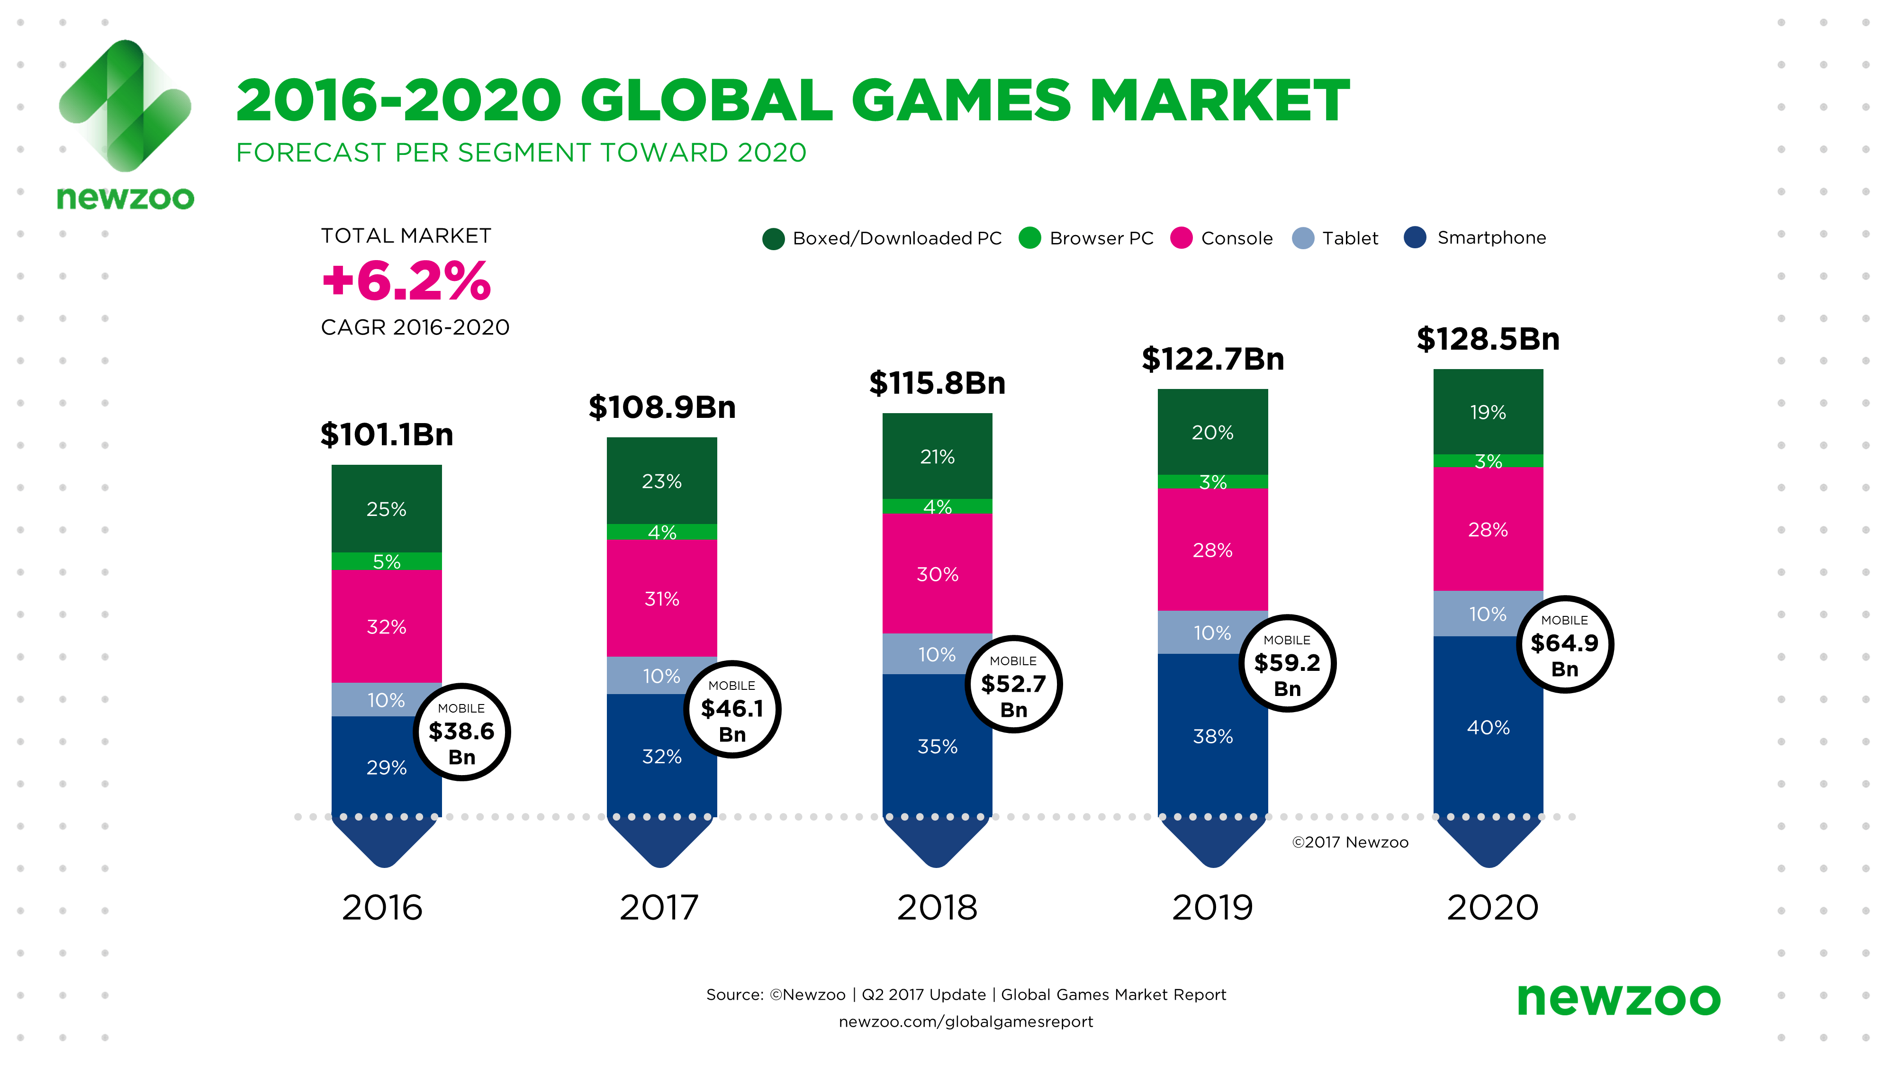
Business Plans

Slide 4
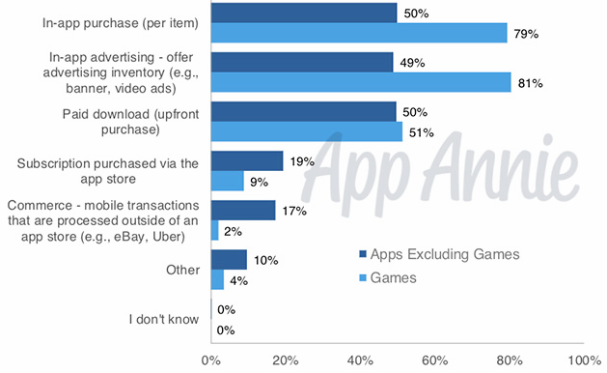
Financial Model

Slide 5
Game Time
https://kentcom.pythonanywhere.com/

Slide 6
Sprint 1 :
Logo.
Vision Statement.
Business Plan.
User Interface.
Rules.

Slide 7
Sprint 2 :
Database Design.
Game Play page.
Sign In page.

Slide 8
Sprint 3 :
List of Questions.
Inserting questions in database.
Displaying questions on the gameplay page.
Some minor modification in the User Interface.
Game Over Page.

Slide 9
Team :
Deep Vakharia : President Of Organisation KentCom.
David Porter : Marketing Manager.
Karishma Patil: Resource Manager.
Pavan Poudel : Project Manager.
Suman Batta : Quality Assurance Analyst.
Bhavy Bhat : Software Developer.
Sanjay Krishnamurthy Narayana : Software Developer.
Chethana Laxmi Vemparala : Software Developer.
Sankar Nadendla : Software Developer.

Slide 10
Thank You

